Slide 1


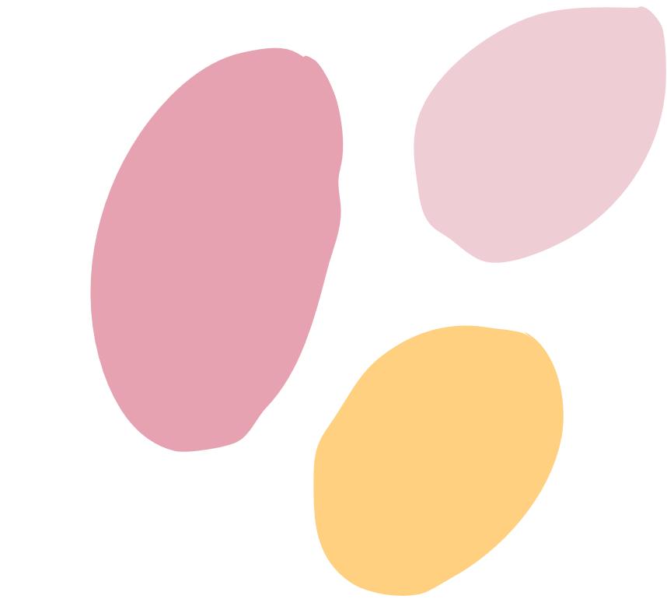





AI SKIN Analyzer
for Skin health

Slide 2


team members
Ahmed Ismail El Sayed
toka magdy FEKRY
Ann Michel Yacoub
Haya Mohamed Mahmoud
Moatasem Aboubakr
Mohamed Sameh
Under the Supervision of ENG: Abdelrhman Elmashtoly

Slide 3

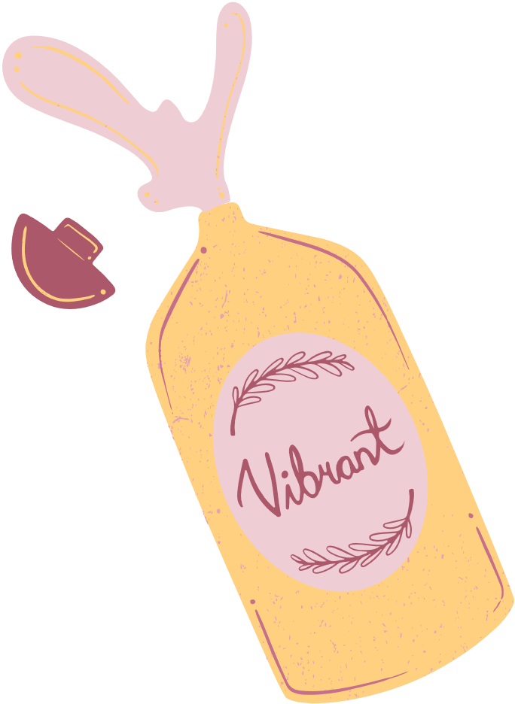
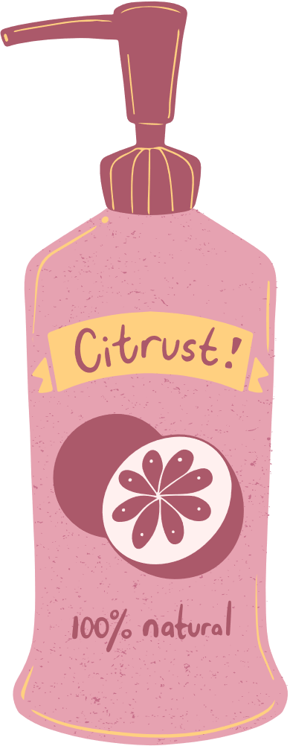

Introduction
Our project introduces an intelligent AI system designed to analyze skin conditions with accuracy, speed, and accessibility. By combining deep learning image classification with a smart skincare chatbot, the system helps users understand their skin concerns, receive personalized recommendations, and make informed decisions about their daily routines.

Slide 4

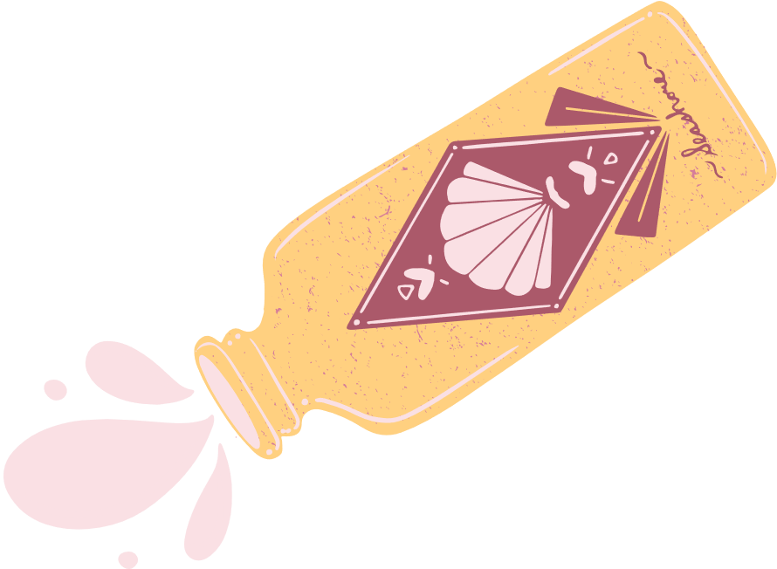


Why Do We Need a Skin Analyzer?
Skin Issues are Complex
Accessibility & Cost
Early Detection is Key

Slide 5



What Our AI System Does
• Classifies the skin into 5 key conditions (acne, pores, blackheads, wrinkles, and dark circles)
• Provides personalized skincare routines and product suggestions
• Supports users with an integrated AI chatbot for explanations and guidance

Slide 6



Data collection
Data Sources
Dataset Distribution
• Acne: 2,060 images
• Blackheads: 1,970 images
• Dark Spots: 2,126 images
• Pores: 1,632 images
• Wrinkles: 1,982 images
• Kaggle datasets
• Roboflow public datasets

Slide 7
Data Preprocessing (Image Augmentation)
Rescale: Normalizes pixel values to improve model stability.
Rotation Range: Random rotations to make the model rotation-invariant.
Horizontal Flip: Adds variation by flipping images left–right.
Vertical Flip: Enhances robustness by flipping images top–bottom.
Brightness Range: Adjusts brightness to handle different lighting conditions.
→ These augmentations increase dataset diversity, reduce overfitting, and help the model achieve better generalization.

Slide 8



Model Architecture

Slide 9
Custom CNN Model
Convolution Blocks:
Block 1: Conv2D 32 → BatchNorm → ReLU → Conv2D 32 → BatchNorm → ReLU → MaxPooling
Block 2: Conv2D 64 → BatchNorm → ReLU → Conv2D 64 → BatchNorm → ReLU → MaxPooling
Block 3: Conv2D 128 → BatchNorm → ReLU → Conv2D 128 → BatchNorm → ReLU → MaxPooling
Block 4: Conv2D 256 → BatchNorm → ReLU → MaxPooling
Dense Head:
Flatten → Dense 512 → BatchNorm → ReLU → Dropout 0.3 → Dense 5 (Softmax)

Slide 10
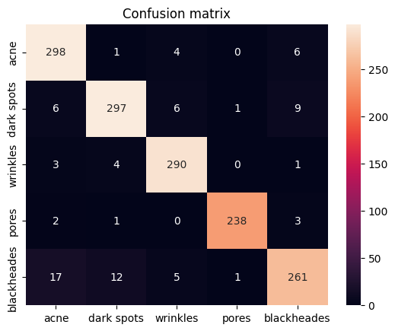
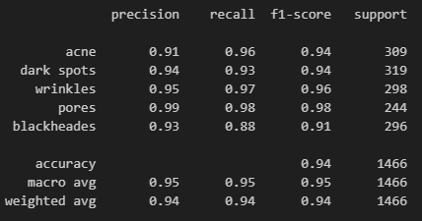
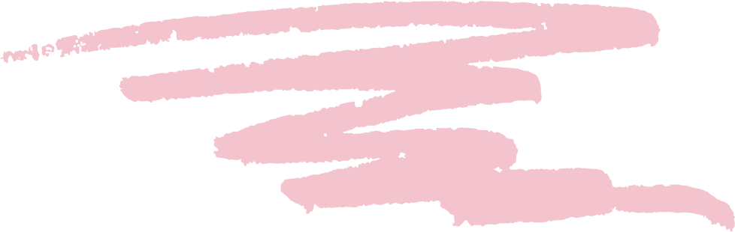
Confusion Matrix & Classification Report

Slide 11
VGG16 Model
Base Model:
Pretrained VGG16 used as feature extractor
All base layers frozen (not trainable)
Custom Dense Head:
Flatten → Dense 512 → ReLU → BatchNorm → Dropout 0.5
Dense 128 → ReLU → BatchNorm → Dropout 0.3
Output Dense → Softmax

Slide 12
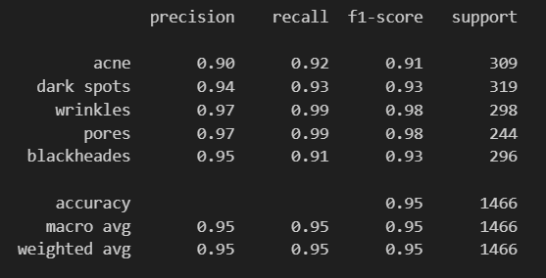
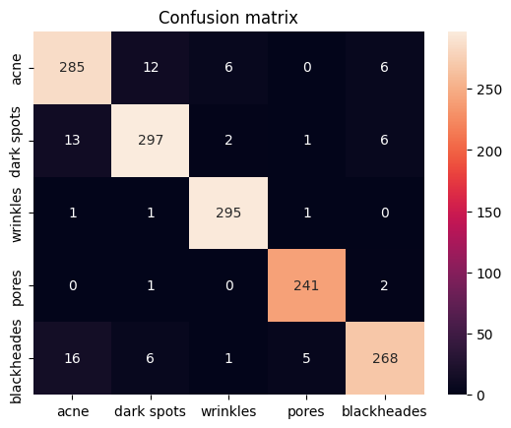
Confusion Matrix & Classification Report

Slide 13
ResNet50 Model
Base Model:
Pretrained ResNet50 used as feature extractor
All base layers trainable (fine-tuning enabled)
Custom Dense Head:
Flatten → Dense 512 → ReLU → Dropout 0.5
Output Dense → Softmax → 5 classes

Slide 14
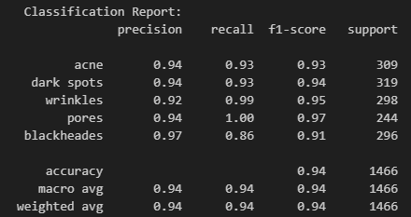
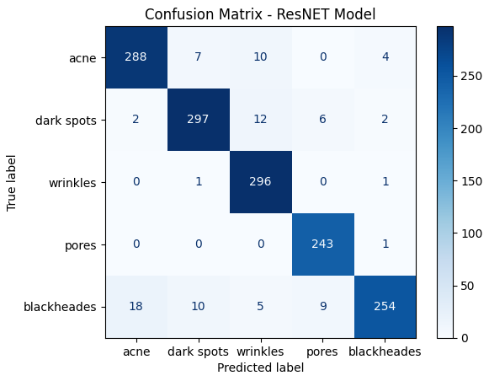
Confusion Matrix & Classification Report

Slide 15
Chatbot Overview

Slide 16
AI Skincare Assistant
Interprets and explains the detected skin condition.
Provides personalized skincare routines and product recommendations.
Responds to user queries with clear, supportive guidance.

Slide 17
How the Chatbot Works
• Powered by LangChain to manage the full RAG pipeline
• Uses RAG (Retrieval-Augmented Generation) to search stored knowledge
• Retrieves routines, product details, and skin condition insights
• Built with FAISS + Embeddings for fast and precise vector search
• Uses Mistral LLM + custom prompts to generate grounded, reliable answers

Slide 18
Challenges

Slide 19
Challenges & Solutions
Wrong chatbot answers → Implemented a smart router function to direct queries to the appropriate response logic.
Irrelevant questions → Applied similarity filtering to ensure only contextually relevant responses are provided.
Smart Router Steps:
Similarity Check → If irrelevant → friendly rejection
Skincare Question? → Yes → use RAG for accurate answers
Advanced Question? → Yes → use LLM Fallback Model

Slide 20
Challenges & Solutions
No available dataset for skin issues → Collected data manually from Kaggle and RobFlow to create a custom dataset for training.
Library version conflicts (LangChain & TensorFlow) → Resolved by running the LangChain chatbot model on Kaggle, and using FastAPI + ngrok to provide an HTTP endpoint.
This allows the model to run locally on a Streamlit GUI for classification and chatbot functionality without library version conflicts.

Slide 21
System Workflow

Slide 22
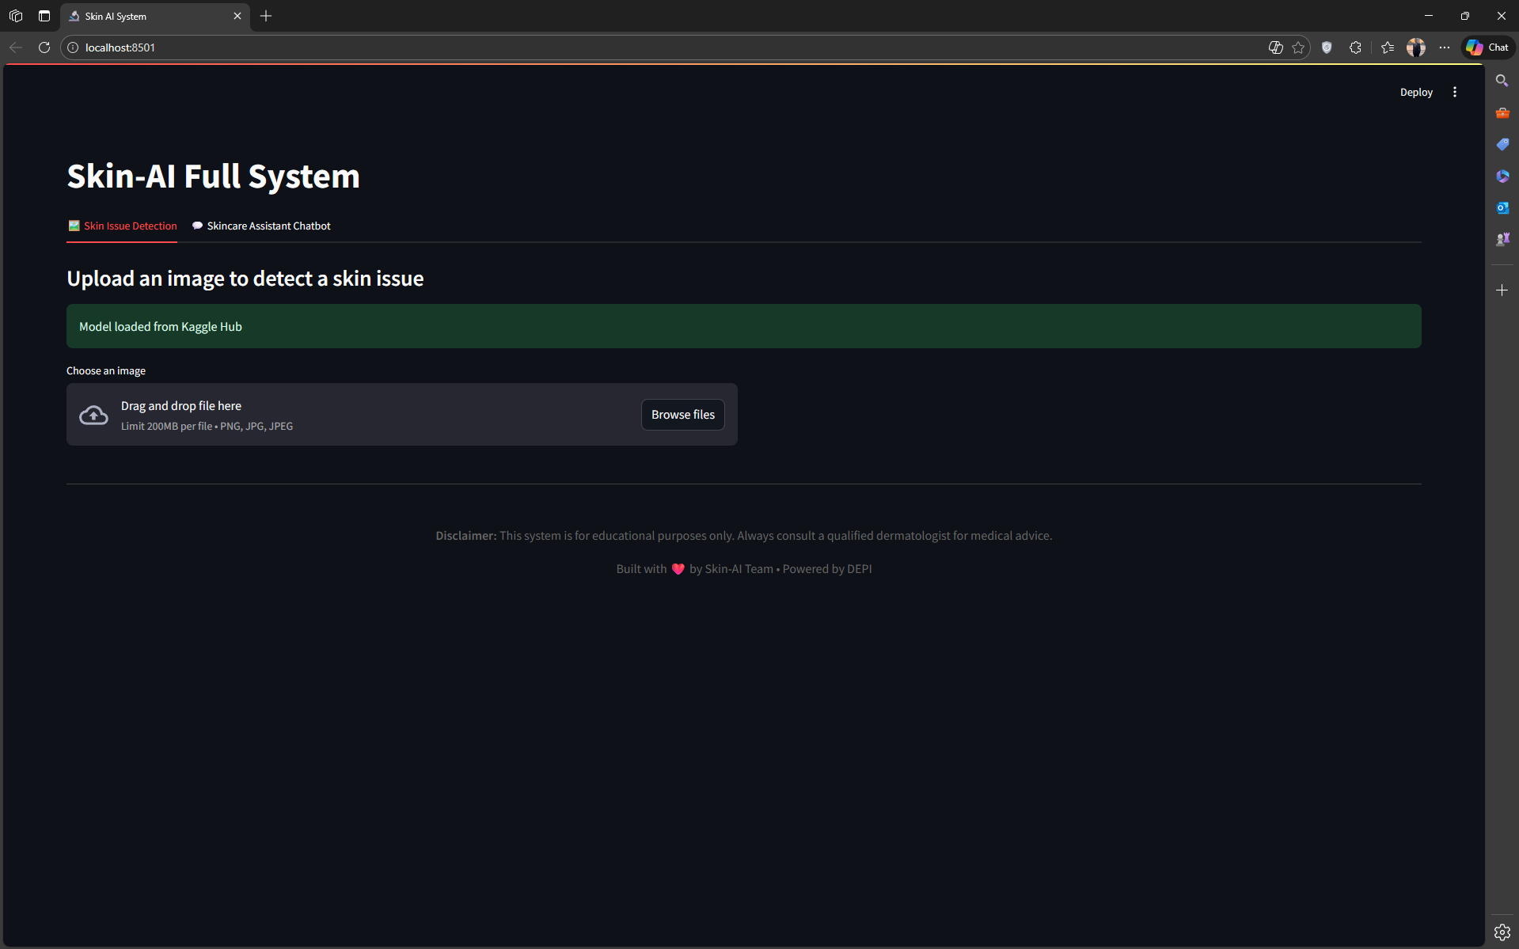

Slide 23
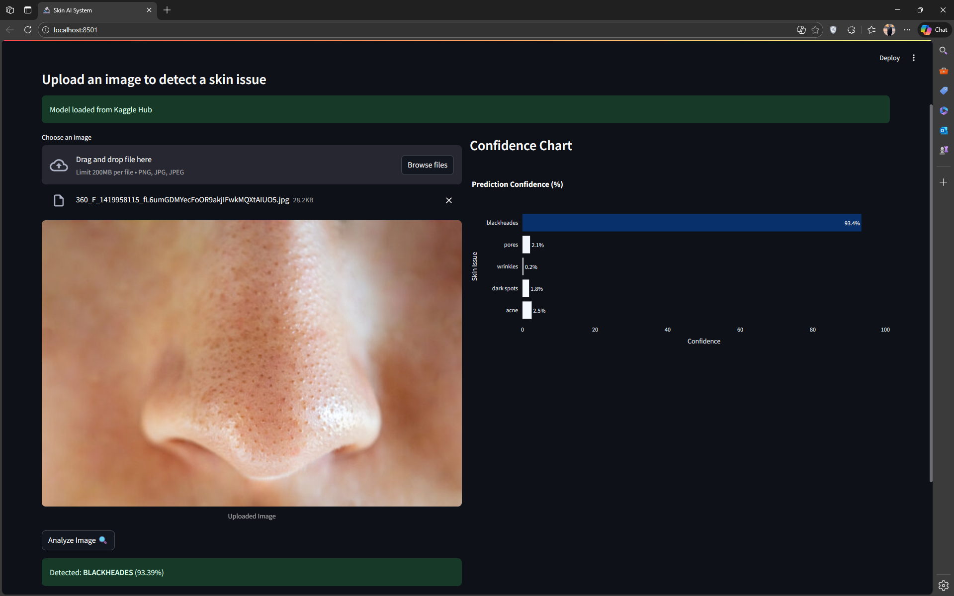
10

Slide 24
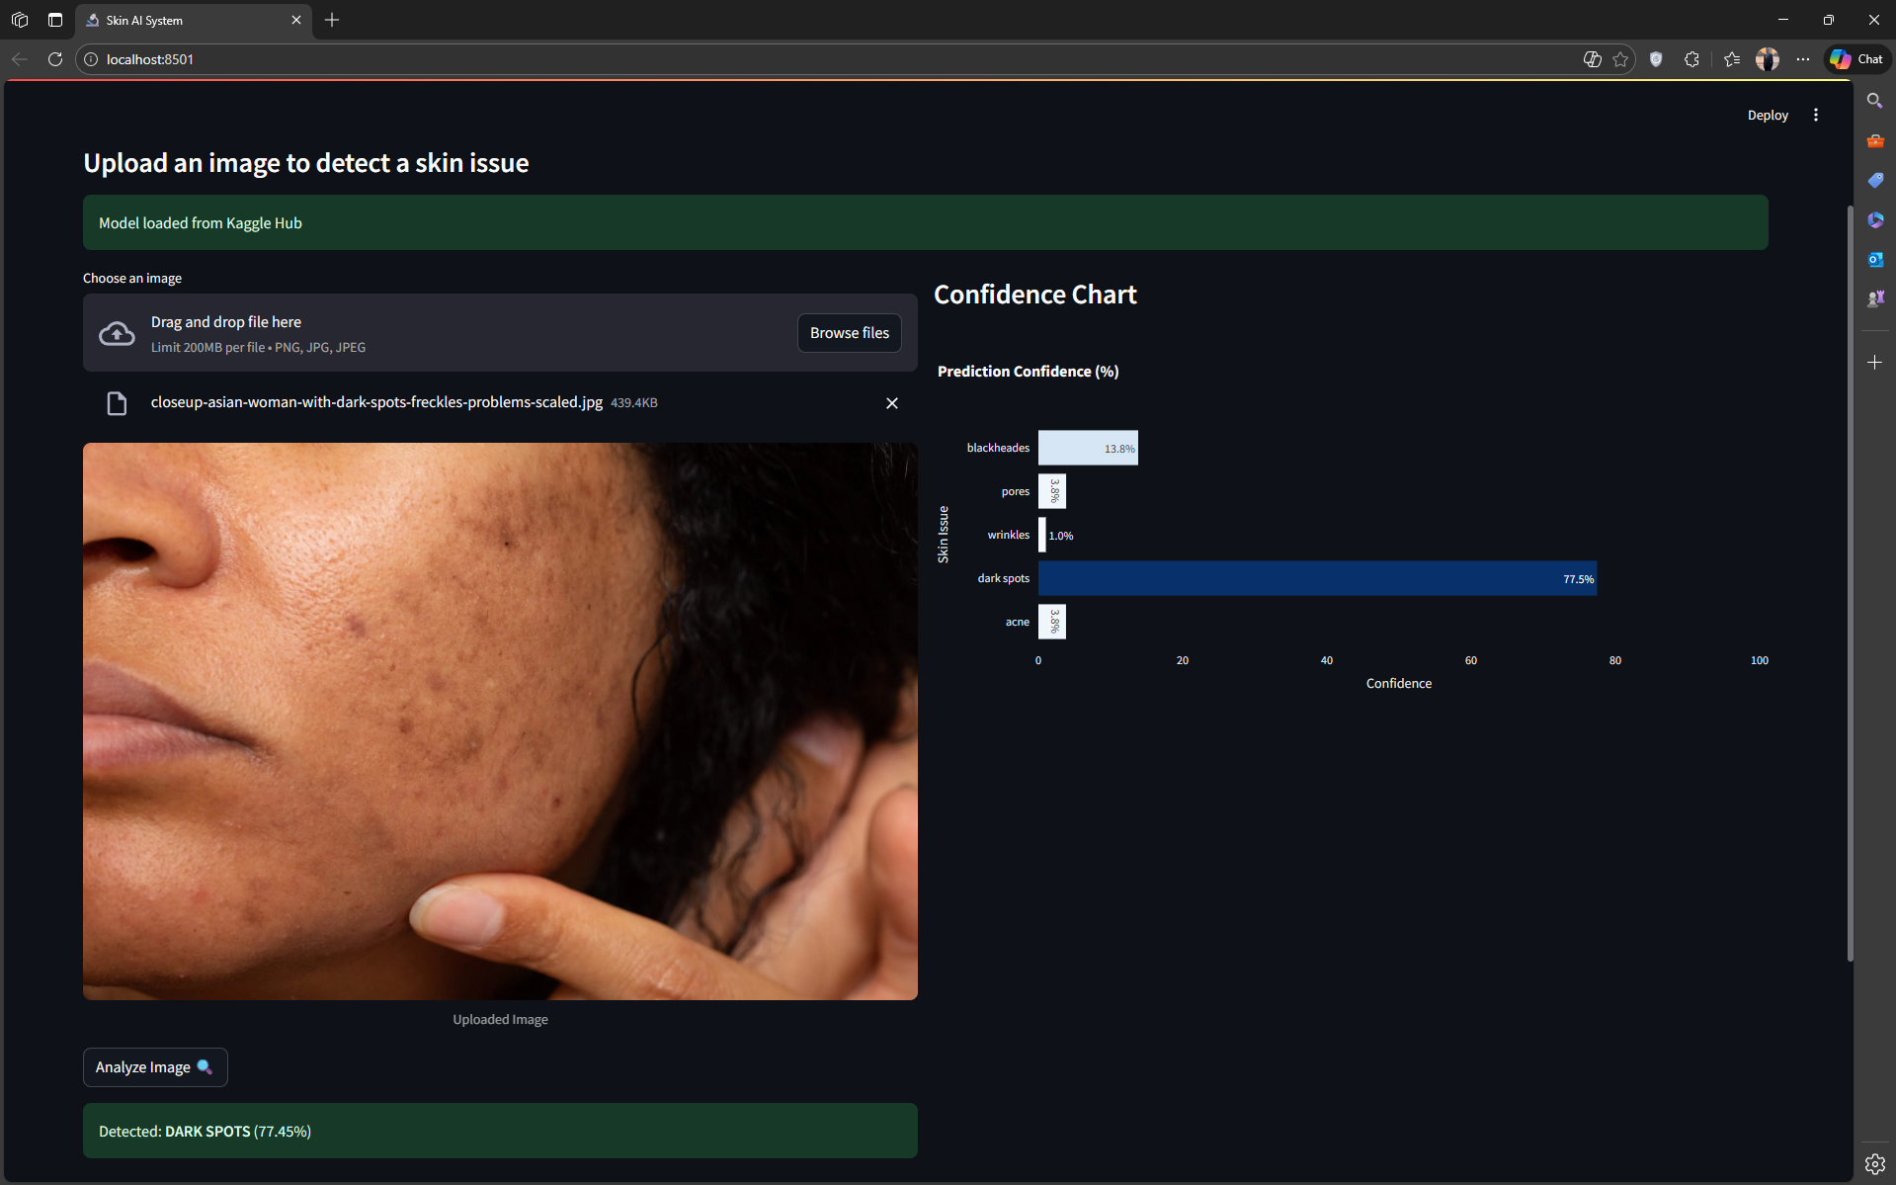

Slide 25
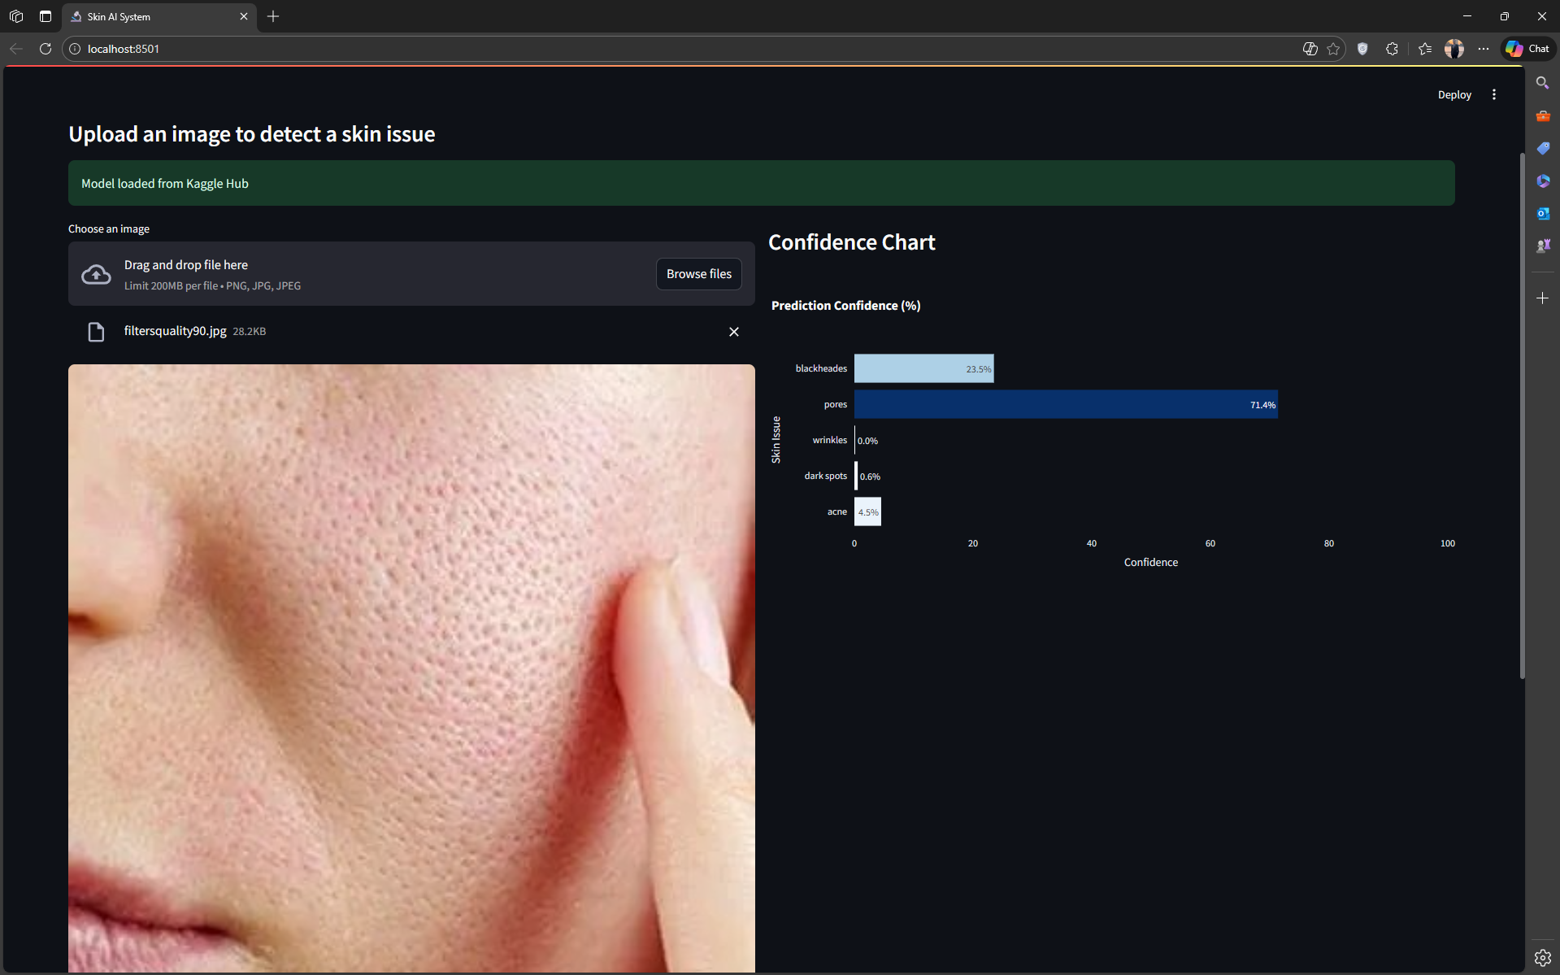

Slide 26
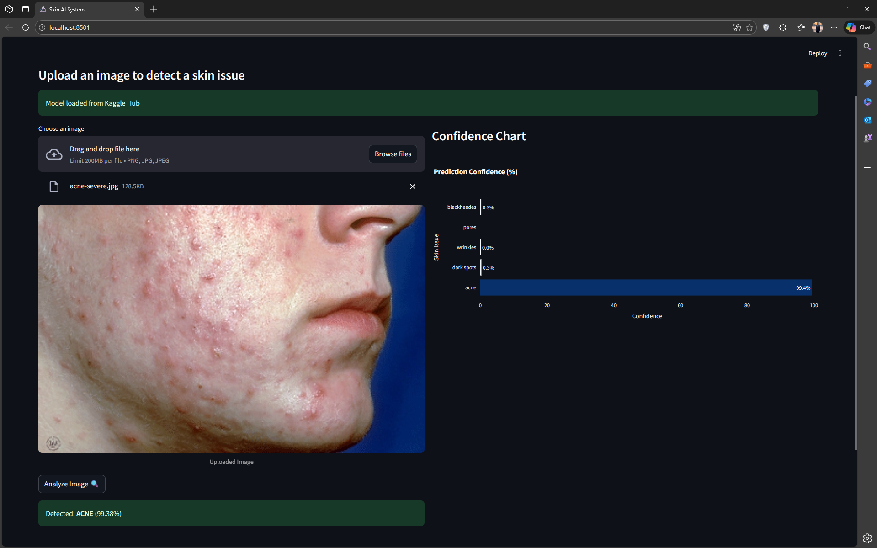
10

Slide 27
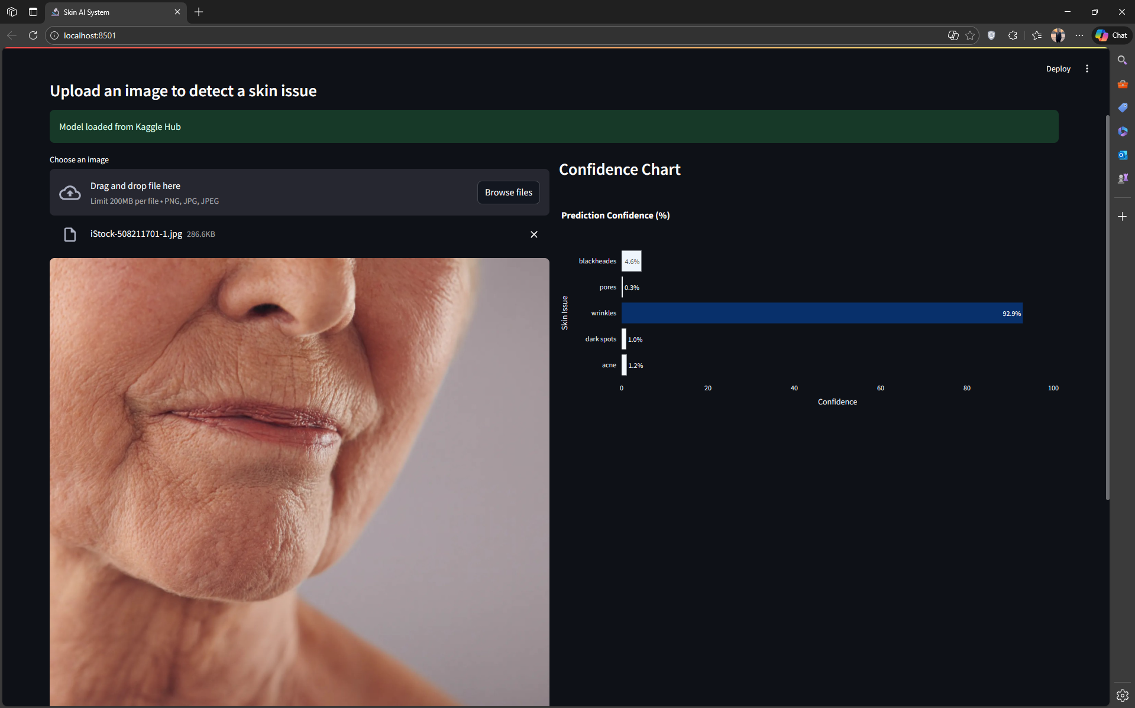
10

Slide 28
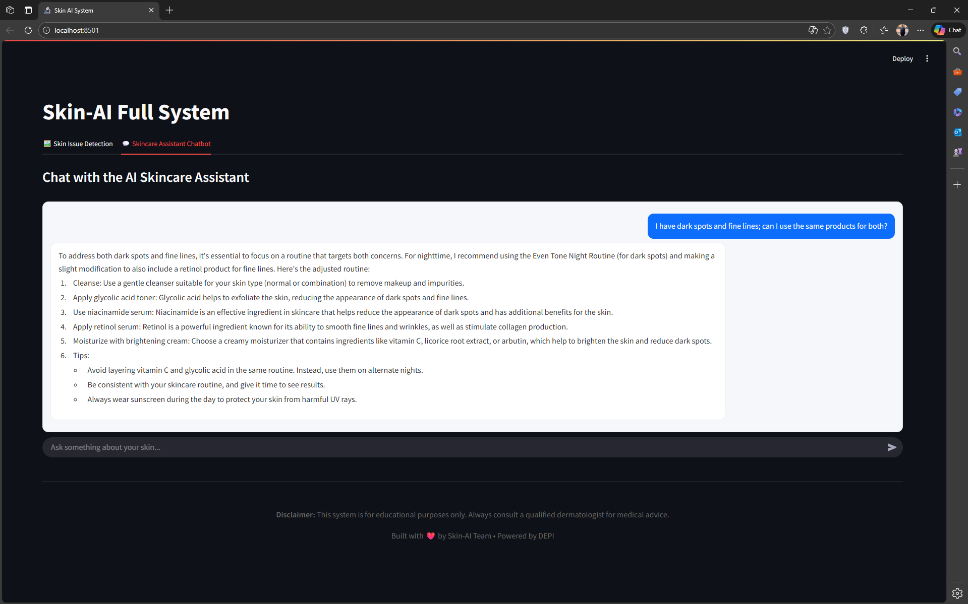
10

Slide 29
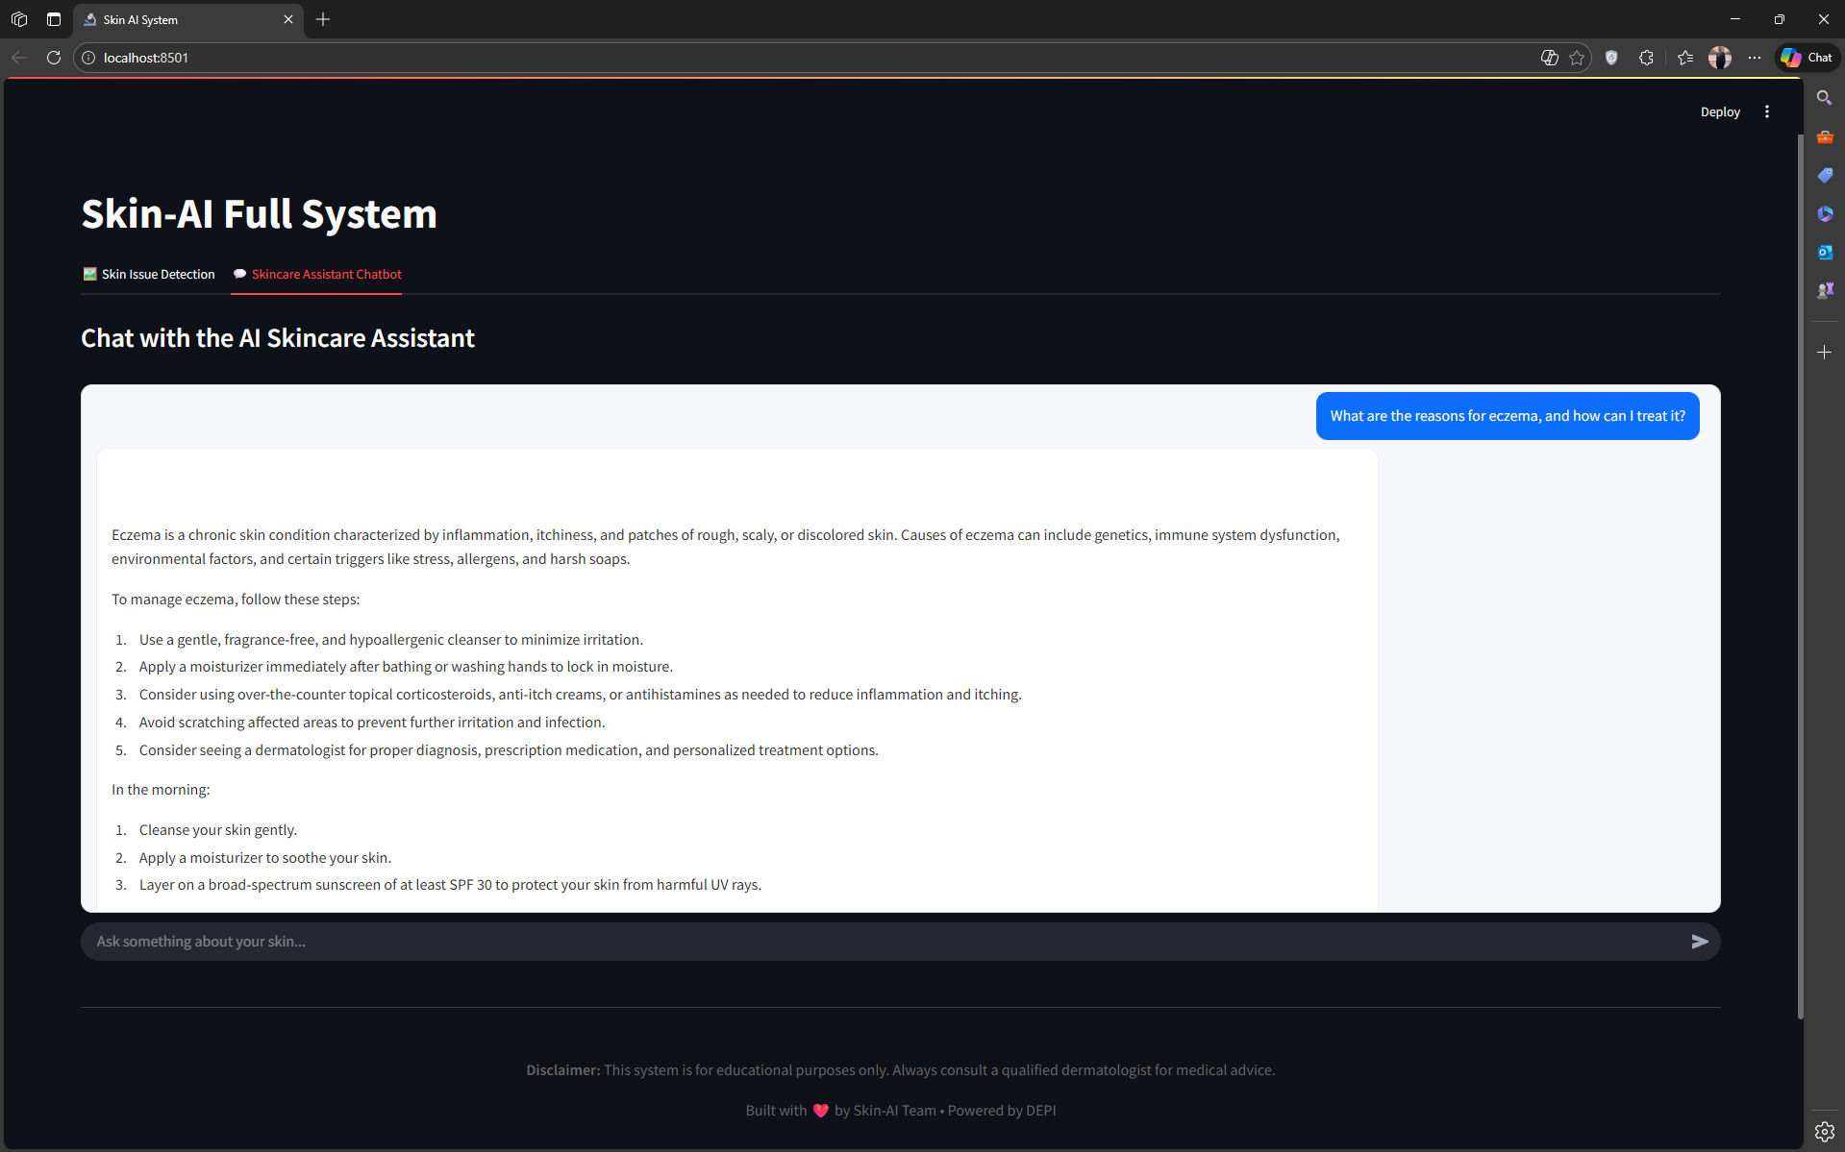

Slide 30
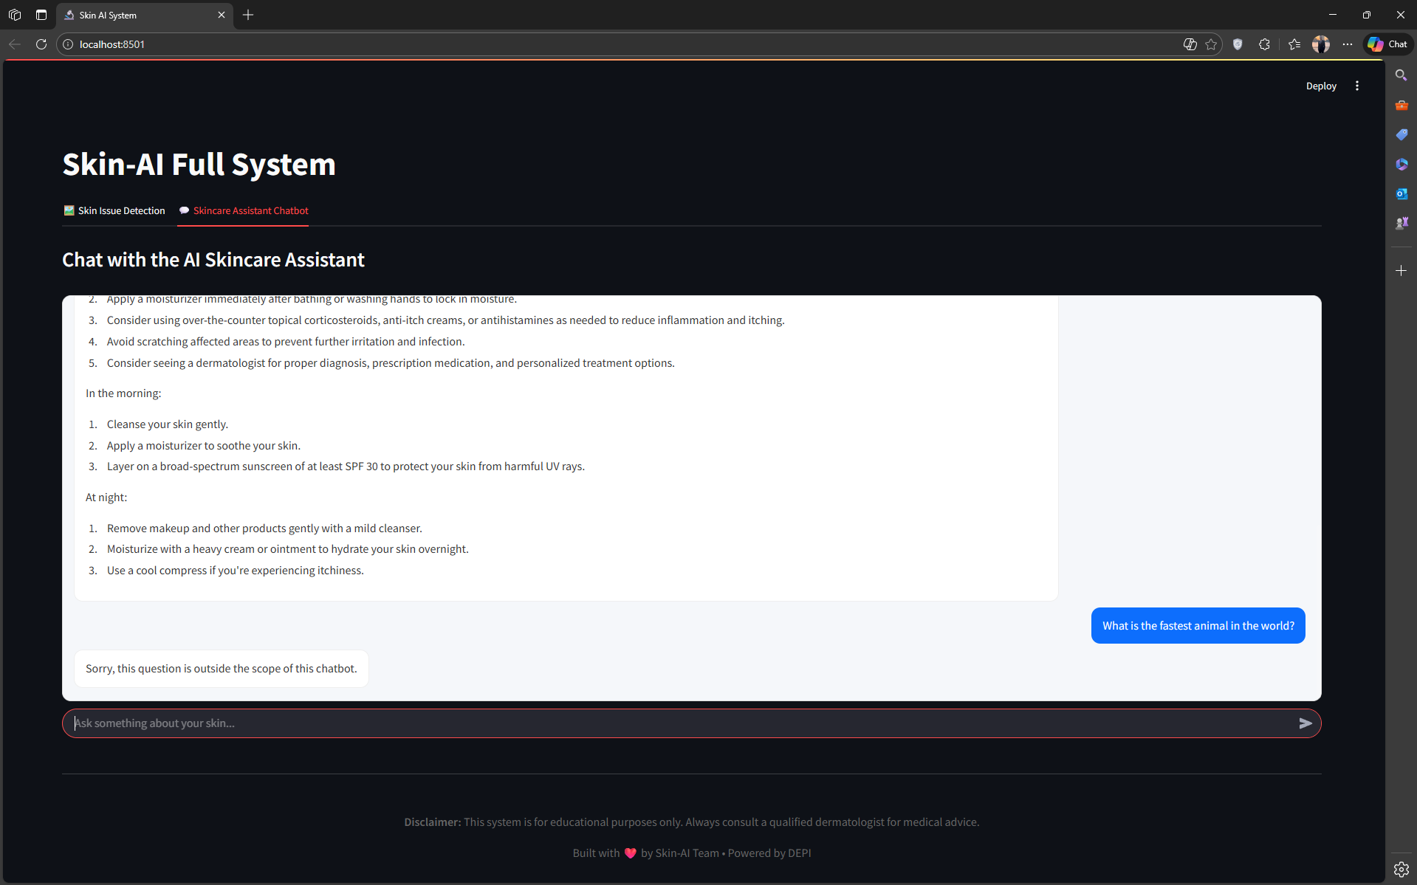
10

Slide 31

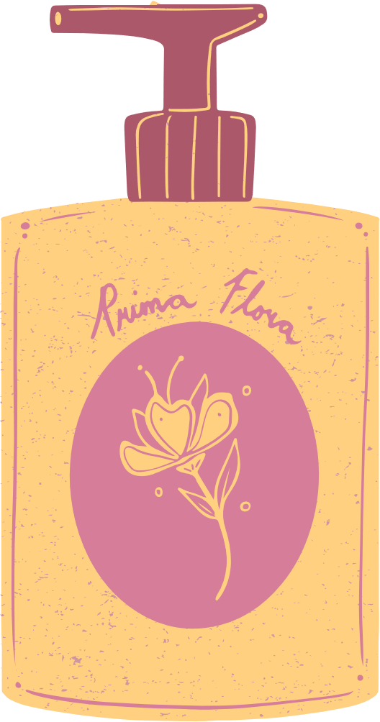
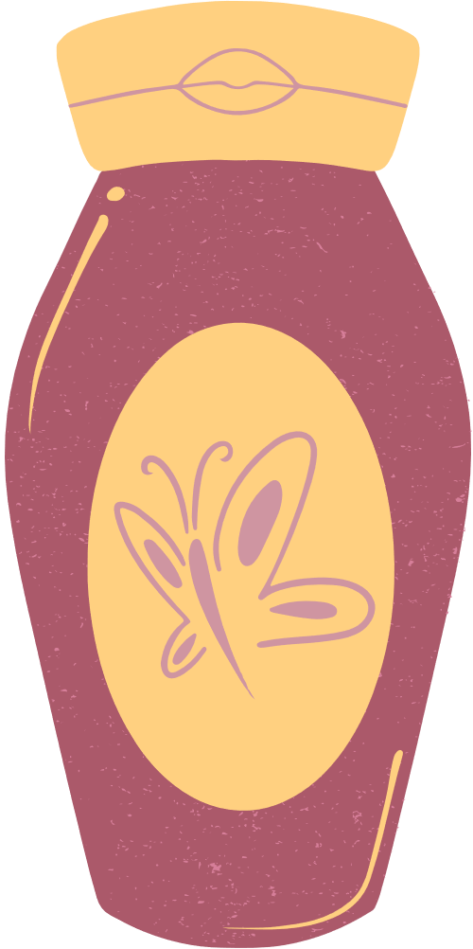
Thank You

